Slide 2
It’s our Christmas Competition time again!

Slide 3
One child in every school will win a BOX of LEGO to make with their family at Christmas Time!

Slide 4
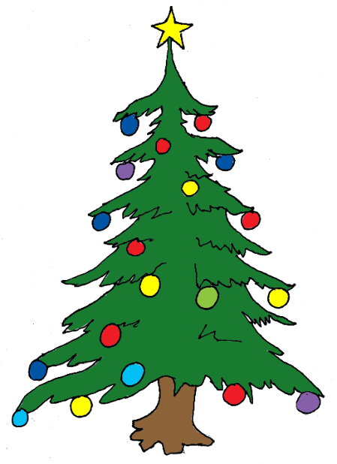
Your challenge, should you wish to accept it…. Is to make a Christmas Tree Decoration out of recycled materials..

Slide 5
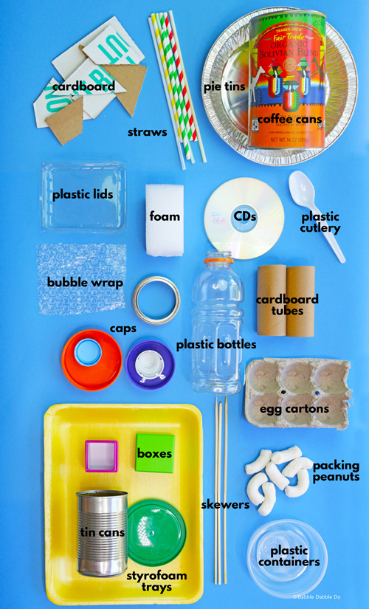
Recycling

Slide 6
Can you guess what recycling these tree decorations are made from?

Slide 7
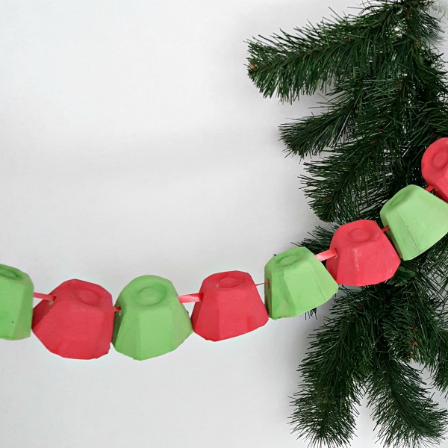

Slide 8
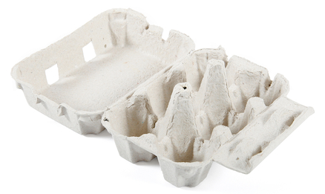

Slide 10
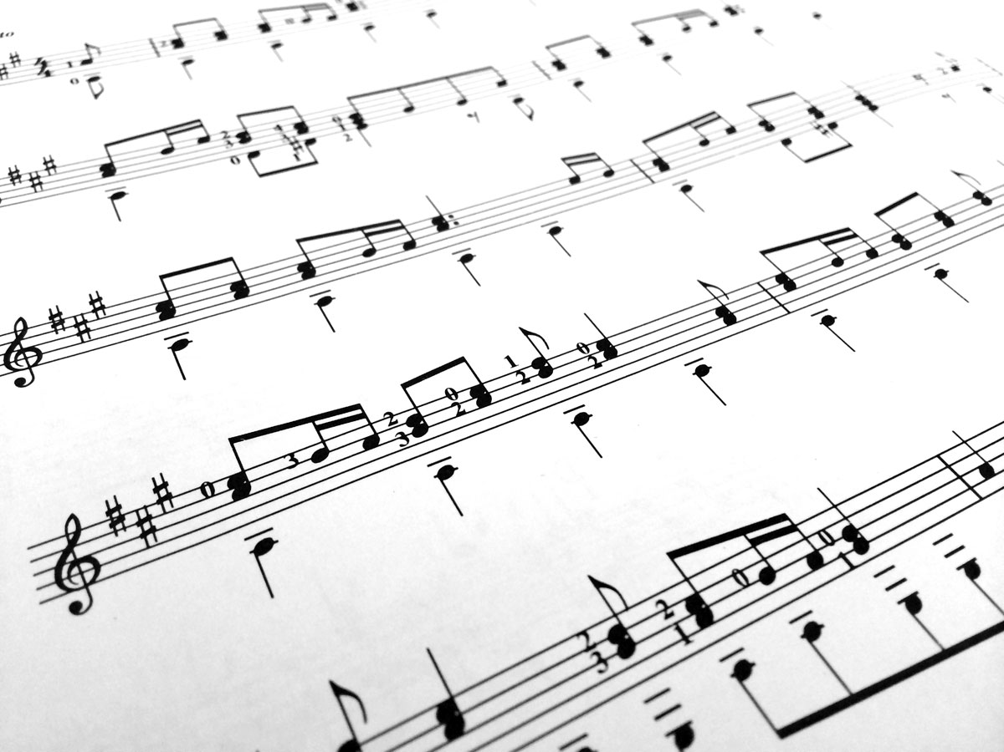

Slide 14
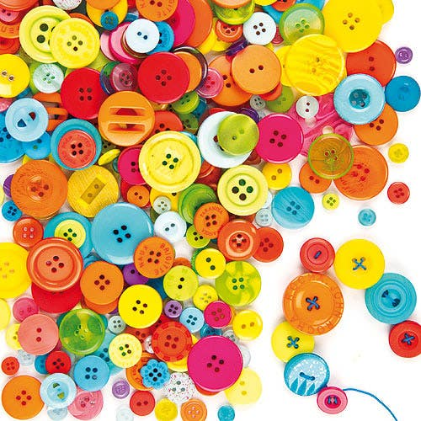

Slide 15
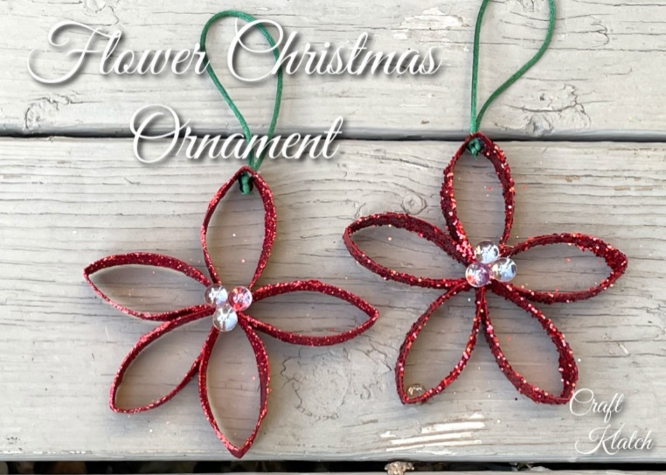
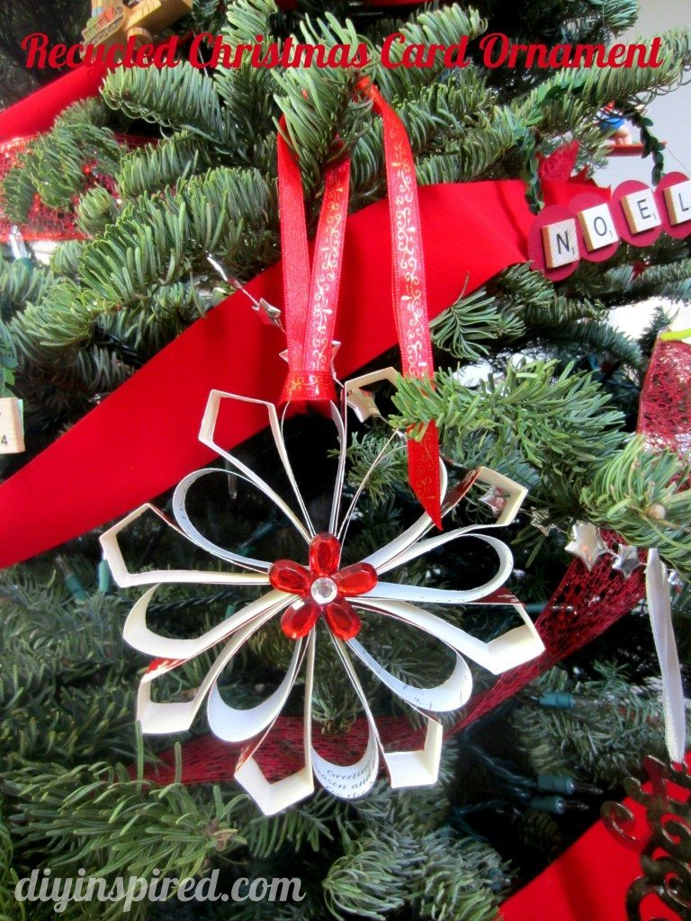
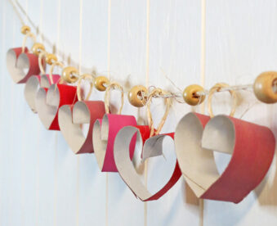

Slide 16
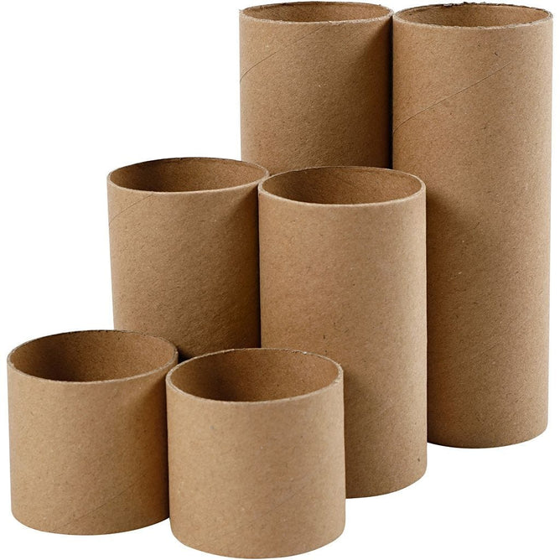

Slide 18
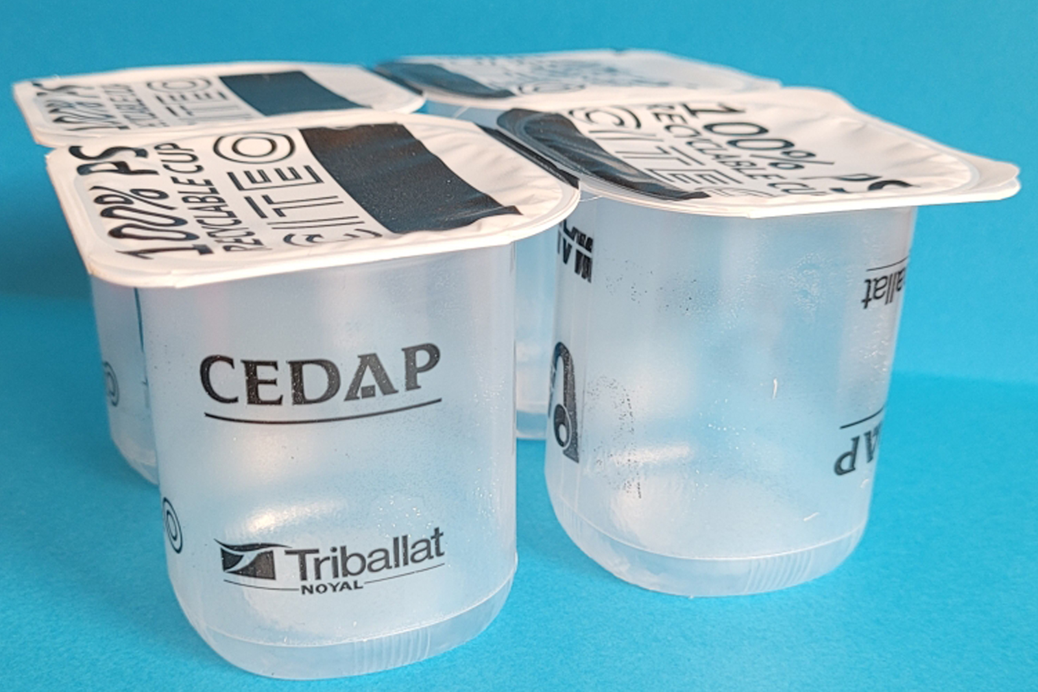

Slide 19
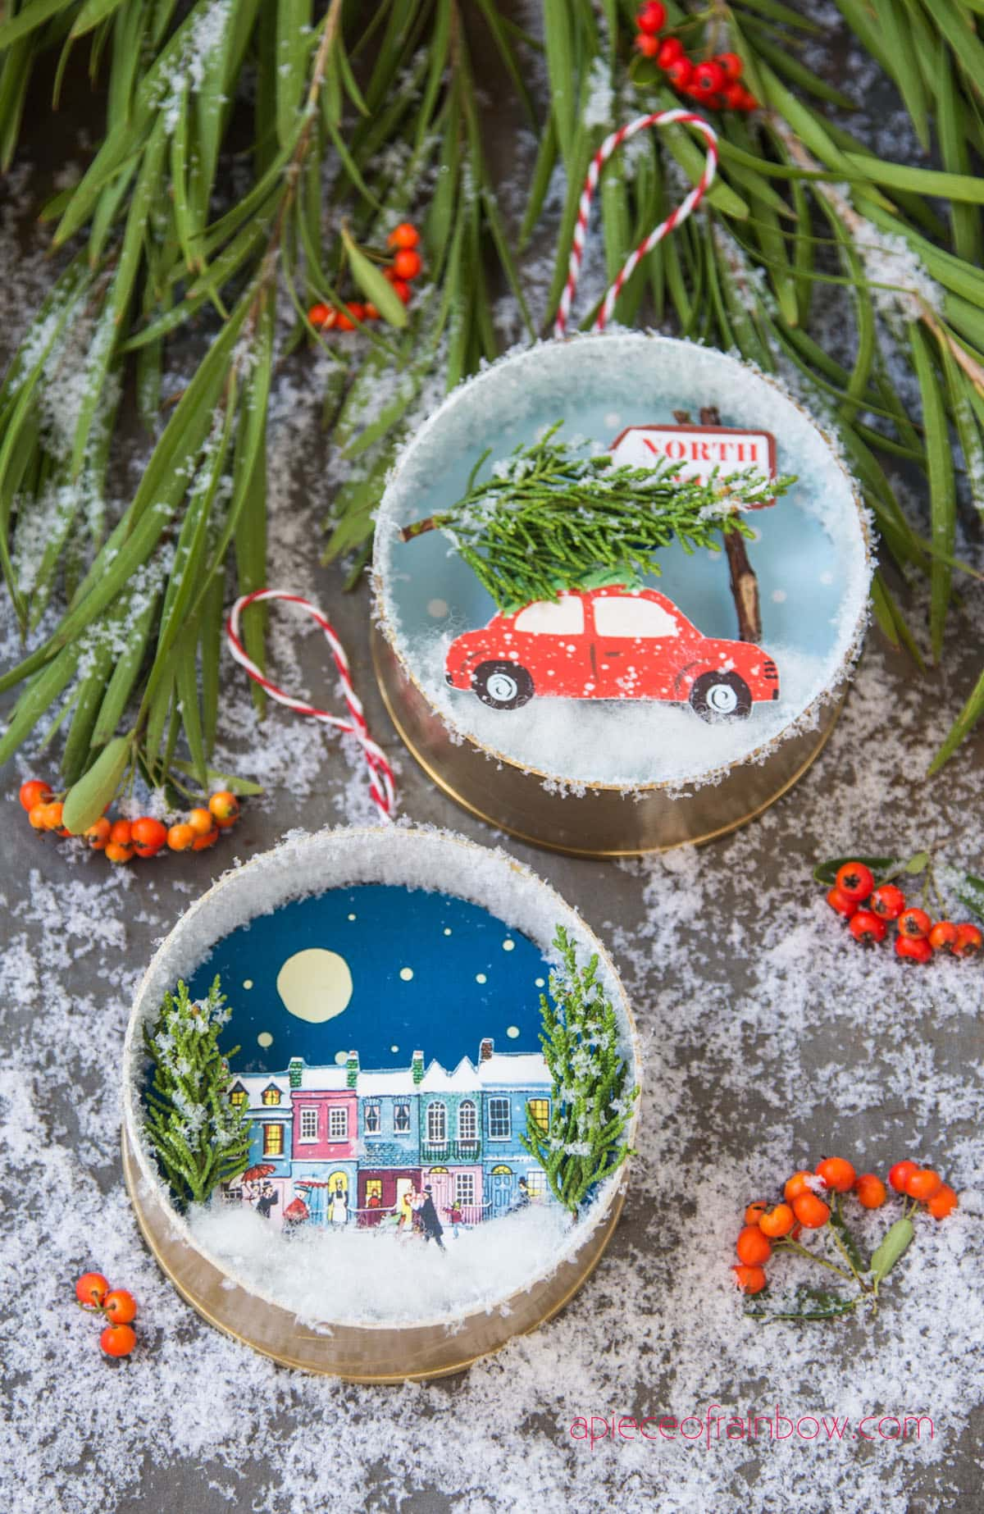

Slide 20
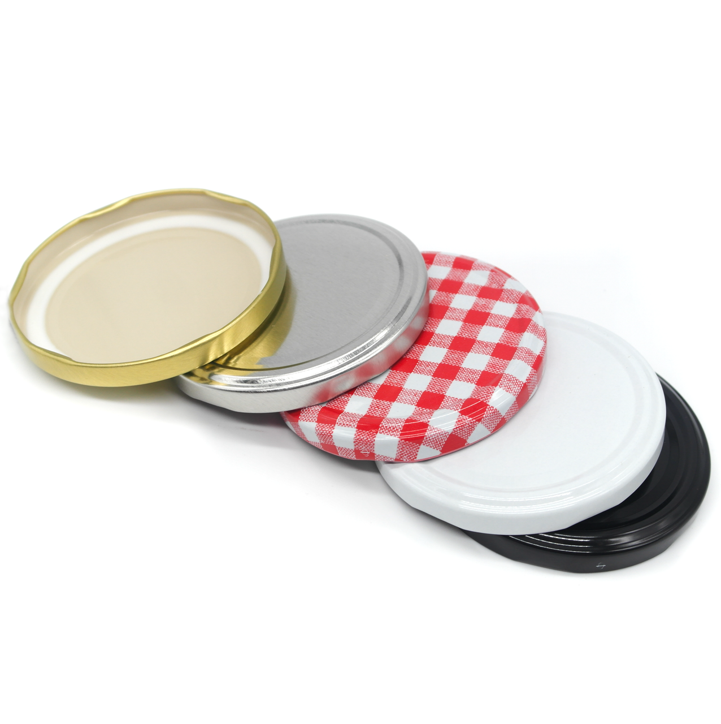

Slide 21
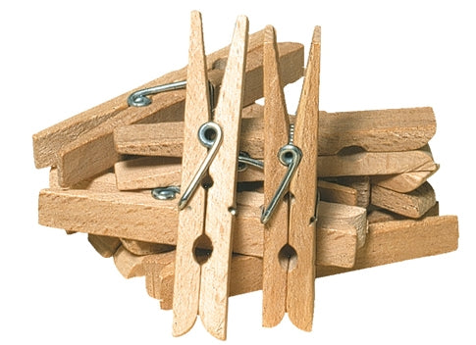
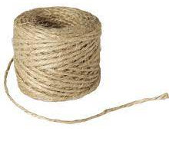
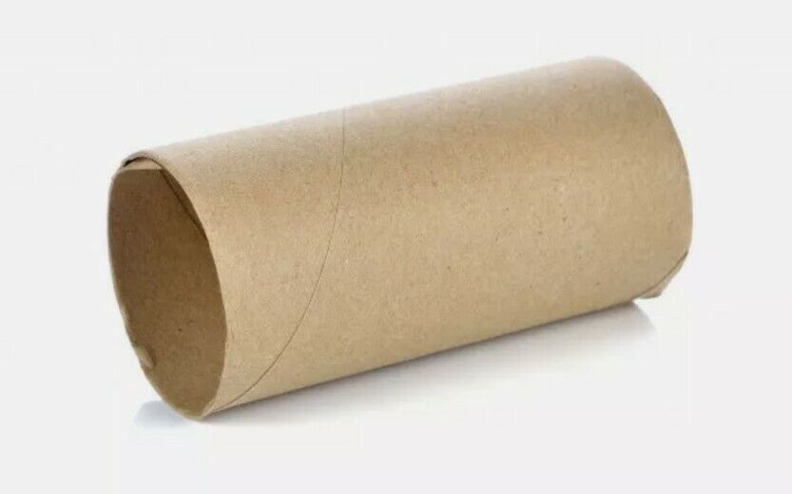
How can you attach your decoration to a tree?
Clothes Peg String
Cone Tube

Slide 22
Recycling
Please use…..
Things you already have at home
Your
Imagination

Slide 23
Name …………………………………….
Year Group …………………….......
School …………………………………..

Slide 25
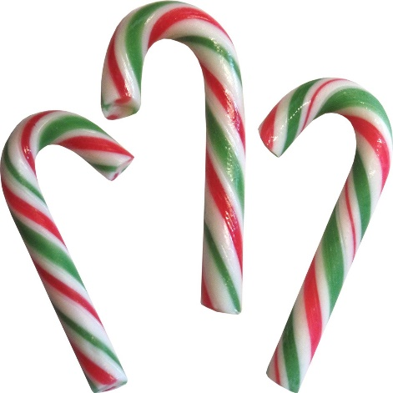
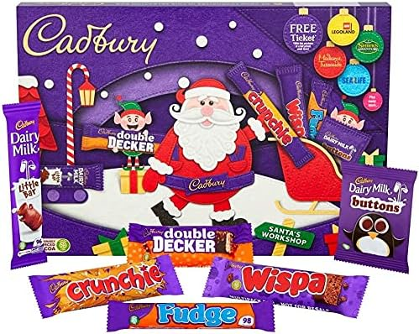
Please bring your entries to our Henry Adams office for a sweet treat or back to your school by Thursday 30th November

Slide 28
Good Luck Everyone! We look forward to returning in December to see all your amazing Christmas Tree Decorations and to award you with your Lego prizes!

